Slide 1
TECHNICAL CHALLENGES/ DETAILS

Slide 2
Technical Details/ Challenges
Hardware
Whether the range of antennae is enough?
What about interference among antennae?
We are using UHF range so minimum interference?
Software
How exactly does software is able to differentiate between users and books?
How does the system know when you remove a book from the RFID?

Slide 3
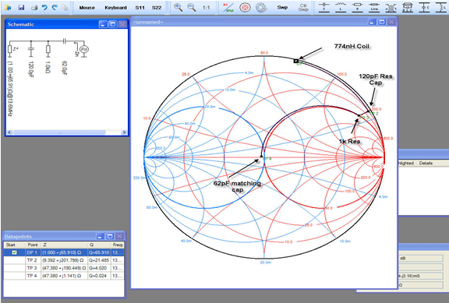
Smith chart - simulations

Slide 4
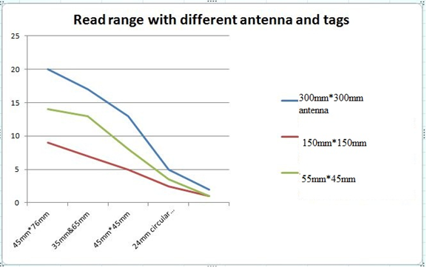

Slide 5
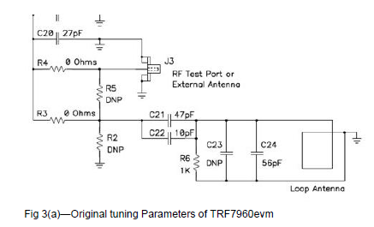
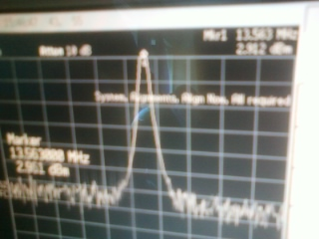
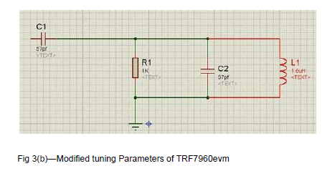
Hardware - Circuits

Slide 6
Software - Mathematical model
Set of all n books B
B = {b₁,b₂,b₃,b₄ … b_{n}}
Set of all m geographic positions
Ω = {p₁, p₂, p₃ ….. p_{m}}
There will be a injection from Ω to 3D Euclidian space.
Set of all i users
U = {u₁,u₂,u₃,u₄ … u_{l}}
Using sets above, we define a injection as follows
Ƒ_{t}: B → U+ Ω
s.t
F(b_{i}) = u_{k} if b_{i} is issued
F(b_{i}) = p_{k} otherwise
Notes:
This is a very precise and profound description of the system

Slide 7
Mathematical model
In this model we have only two states for each book.
ISSUED_WITH_USER_X
WITH_SYSTEM_AT_LOC_X
In earlier system there were three states
WITH_SYSTEM_AT_UNKNOWN_LOC
WITH_SOME_UNKNOWN_USER
ISSUED_WITH_USER_X
Implications/ Benefits of “We always know where the book is.”
Enhanced security
Statistics and machine learning/ recommender system on data.
Similarly other attributes of user and books can be defined by injection which is par se with the earlier model.
µ₁: U → A₁^{s}
µ₂: B → A₂^{s}

Slide 8
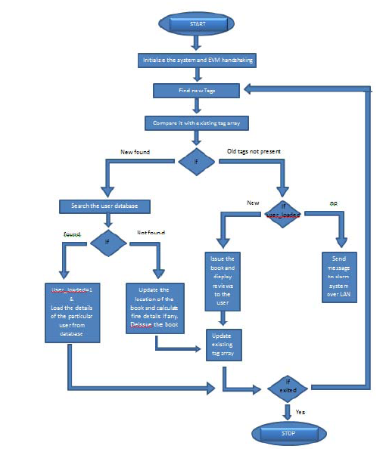
Notes:
Improve the condition of this flow
Possibly include diagrams for visualization of stack or memo (dictionary)

Slide 9
Data structures
Structure of data
User/ Books
(“key”, “value”) pairs uniquely identifiable by “key”.
Value may contain set of entries. These set will act as additional metadata for that “key”.
Book’s name
Author
User’s details etc.
Local copy of tags
Just an array of strings.

Slide 10
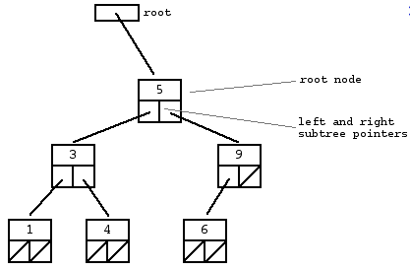
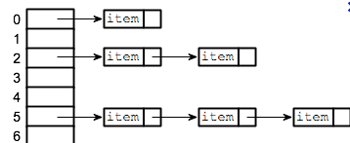
Data structures
Local copy of tags will be small so BST.
Lexicographical order
O(log (n))
A Dictionary/ associative array
Users dictionary will be large.
Books dictionary will be largest.
~O(1)
Possibly to speed up we may use some caching as well.
Based on user present.
Based on user who come frequently.

Slide 11
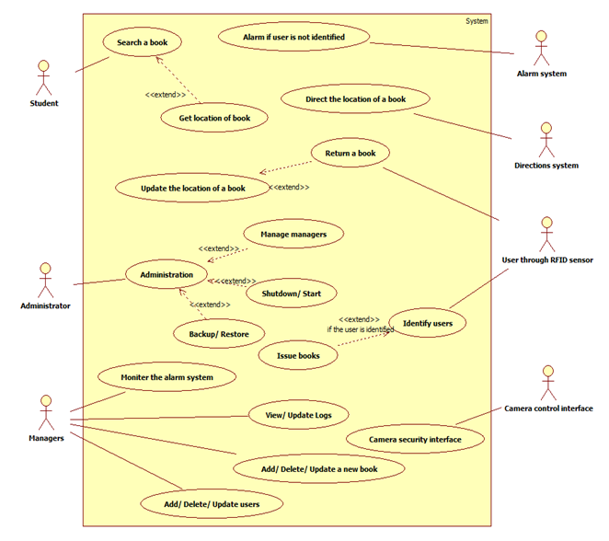
Use case diagram

Slide 12
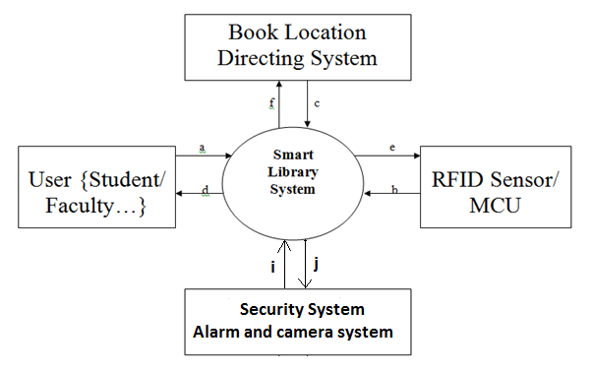
Context free diagram

Slide 13
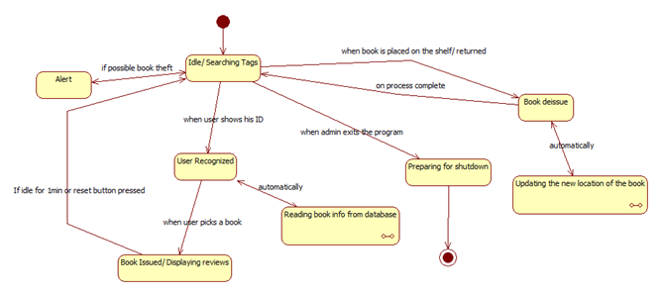
State diagram

Slide 14
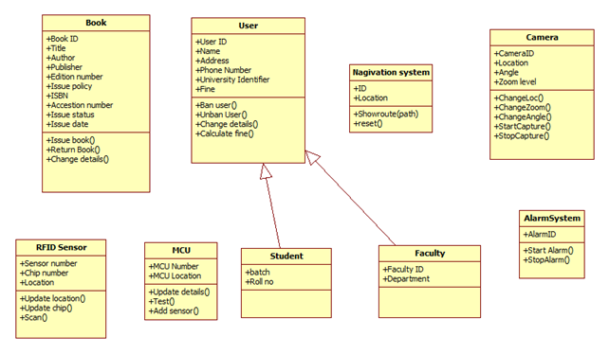
Class diagram

Slide 15
CONCLUSION/ WIND UP

Slide 16
Possible refinements
Freedom to place the book anywhere. Curse or boon?
Categories will lose their meaning soon.
Solution
User can be prompted right when he places the book.
Social and economic policies so that users place books are the right location in the first place.
Security
Unique encrypted signature of university in the RFID tag.
Possibly to enhance security we can detect which user is taking which book at the gate. Thus having two fold security.
Notes:
wE have enough flexibility by the idea that we are able to map books at any time… so many things can be realised

Slide 17
Feasibility
Economically very viable solution
One time investment is required
Pay off period
Later libraries can use this money to buy books.
One time investment will come at the cost of
Really improved and enhanced user experience.
User interact with system not with human beings.
Increased security.
Data statistics can be used to increase library experience.
Find some interesting correlations in data and exploit them.

Slide 18
thankyou
Add comparison chart here…..

